Slide 1
Voltron Segment Routing Architecture
Web Operation
July 2017

Slide 2
Why Does the Host/App Never Appear in our SDN Diagrams?
We produce a lot of “SDN” material depicting controllers pushing instructions to routers and switches
1
AS1
A “Source” requests traffic treatment from a controller via PCEP
Controller pushes label stack instruction to Router via PCEP
Where is the Host/App in SDN architecture diagrams?
pkt
16007
16003
2
3
PCEP
SR
PCE
16002
4
5
BGP-LS
6
7
AS2

Slide 3
Voltron Fundamentals
Give the Host/VM/Container/Application the ability to control its network treatment (Source Routing)
Extend Segment Routing to the Host
Big Data approach to SDN
L4
S0
L6
App
App
ToR100
L5
S1
L7
ToR
200
App
L32
S2
L34
App
Host
With containerized Apps
L33
S3
L35
Host
With containerized Apps
Network Fabric

Slide 4
SDN is a Big Data Problem
Don’t think in terms of “Controller” (controllers tend to be monolithic)
Think in terms of distributed applications (your Facebook page is not assembled by a monolithic ‘web controller’)
Distributed applications = Scaled Microservice Architecture
Metro Fabric
WAN Fabric
DC Fabric
L0
S0
Ln
L0
S0
Ln
L0
S0
Ln
User
T0
L8
S16
Lx
Tn
L8
S16
Lx
Tn
L8
S16
Lx
App
L16
Ly
L16
Ly
L16
Ly
Tn
S32
S32
S32
….
….
….
ASBR
….
….
….
ASBR
….
….
….
L64
S128
Lz
L64
S128
Lz
L64
S128
Lz
https://www.ietf.org/id/draft-filsfils-spring-large-scale-interconnect-03.txt

Slide 5
SDN is a Big Data Problem
Some Voltron Guiding Principles:
Prefer APIs over Protocols
Use new tools: BMP, gRPC, etc.
And BGP (always BGP)
Avoid legacy tools: SNMP, CLI, PCEP, etc. whenever possible
Avoid making config-state changes to Network/Fabric elements
Metro Fabric
WAN Fabric
DC Fabric
L0
S0
Ln
L0
S0
Ln
L0
S0
Ln
User
T0
L8
S16
Lx
Tn
L8
S16
Lx
Tn
L8
S16
Lx
App
L16
Ly
L16
Ly
L16
Ly
Tn
S32
S32
S32
….
….
….
ASBR
….
….
….
ASBR
….
….
….
L64
S128
Lz
L64
S128
Lz
L64
S128
Lz
https://www.ietf.org/id/draft-filsfils-spring-large-scale-interconnect-03.txt

Slide 6
Network Data Collection Infrastructure
Query
TSDB
Batch
Etc
Data Aggregation (Kafka)
PNDA?
Collectors
Telemetry Data
Topology, Label, Prefix Data
L4
S0
L6
App
App
ToR100
L5
S1
L7
ToR
200
App
L32
S2
L34
App
Host
With containerized Apps
L33
S3
L35
Host
With containerized Apps
Network Fabric

Slide 7
Analytics Applications
WAE
GPS RTT*
$ per Gb*
* I made these two up, but they sound like cool analytics apps
Query
TSDB
Batch
Etc
Data Aggregation (Kafka)
PNDA?
Collectors
Telemetry Data
Topology, Label, Prefix Data
L4
S0
L6
App
App
ToR100
L5
S1
L7
ToR
200
App
L32
S2
L34
App
Host
With containerized Apps
L33
S3
L35
Host
With containerized Apps
Network Fabric

Slide 8
Voltron Microservices, API GW, and Host Networking
WAE
GPS RTT*
$ per Gb*
* I made these two up, but they sure sound like cool analytics apps
Path Selection Service
Query
TSDB
Batch
Etc
Voltron
Data Aggregation (Kafka)
PNDA
API GW
Overlay Service
Service X
Collectors
Telemetry Data
Topology, Label, Prefix Data
L4
S0
L6
App
App
ToR100
L5
S1
L7
ToR
200
SR agent
SR agent
App
L32
S2
L34
App
Host
With containerized Apps
L33
S3
L35
Host
With containerized Apps
Network Fabric

Slide 9
Voltron Microservices, API GW, and Host Networking
WAE
GPS RTT*
$ per Gb*
* I made these two up, but they sure sound like cool analytics apps
Path Selection Service
Query
TSDB
Batch
Etc
Voltron
Data Aggregation (Kafka)
PNDA
API GW
Overlay Service
Service X
Collectors
XTC
Telemetry Data
Topology, Label, Prefix Data
L4
S0
L6
App
App
ToR100
L5
S1
L7
ToR
200
SR agent
SR agent
App
L32
S2
L34
App
Host
With containerized Apps
L33
S3
L35
Host
With containerized Apps
Network Fabric

Slide 10
Initial Use Case – BAF Balancer

Slide 11
BAF Balancer
Hardware ECMP is unaware of flow-size (Elephants & Mice problem)
Can lead to traffic polarization and unbalanced network utilization
Most common bottleneck in high radix DC is egress leaf node
S0
L0
L8
L1
S16
L9
C1
H0
T0
T17
H63
C3
L16
S32
L10
C2
….
….
….
Tn
Hn
Cn
L7
L15
S112

Slide 12
BAF Balancer
Container / Application makes High-BW API request
Microservice maintains data cache of all DC Fabric Paths: n(n-1)/2 Leaf-Spine-Leaf tuple mesh (note: formula should be modified to reflect DC-Planes design)
Microservice fields Elephant-flow (High-BW) request, performs ToR-to-ToR lookup from base microservice, and allocates L-S-L label stack
Gap: need feedback loop informing microservice when HiBW flow is complete, so LSL tuple may be returned to ‘available’ status
Role for XTC? Do we execute changes in the network? Or do we keep a table of paths and XTC acts as load balancer?
T0
T1
ToR-to-ToR: 1024 discrete LSL paths
4000 ToRs: n(n-1)/2 = 8M
8M*1024 = 8.2B possible LSL combinations
Elephant Flow Balancer Microservice
Flow Balancer Service
Collector
L0
S0
L0
X
L8
S16
L9
X
L16
S32
L17
Avail
S0
L0
L1
REST or
RPC request
L1
S16
L9
C1
H0
T0
T17
H63
C3
L16
S32
L17
C2
….
….
….
Tn
Hn
Cn
L7
L65
S112

Slide 13
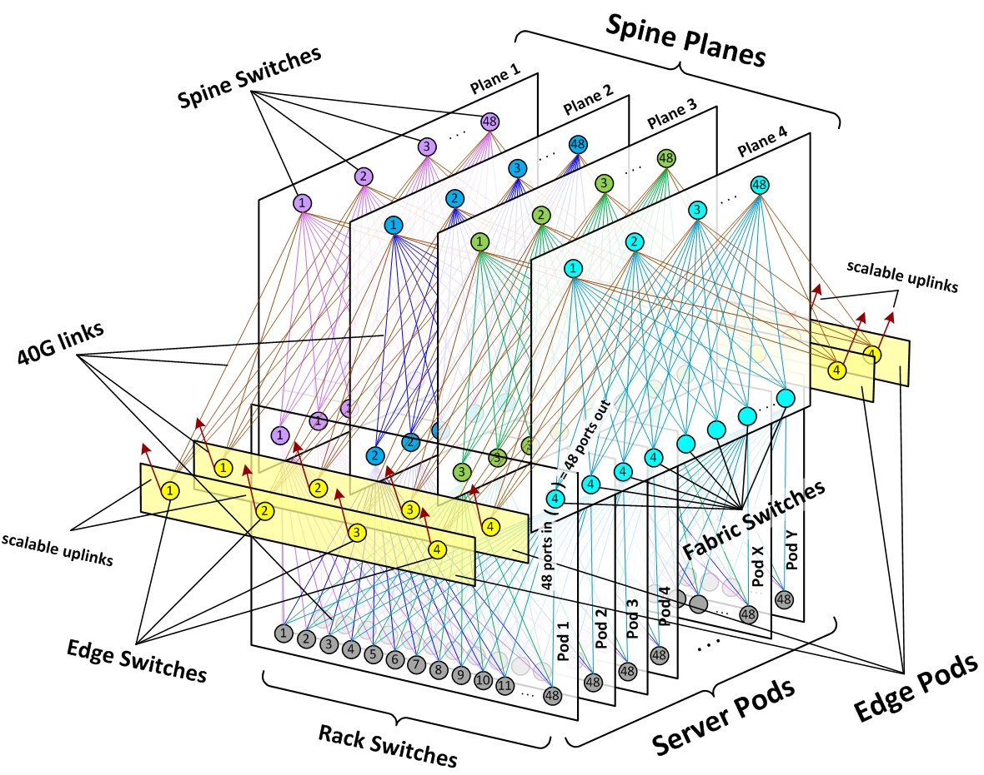
DC Planes Reference – and Anycast SID
Anycast-SID across all or a subset of Spine nodes per plane
Example Application use case:
Reads – no steering
Writes – load balance across DC shards
Anycast SID 20000
20001
20002
20003

Slide 14
Voltron Microservices, API GW, and Host Networking
Path Selection Service
WAE
Query
TSDB
Batch
Etc
Is the Overlay Service simply a BGP VPNv4/6 session with RR?
GoBGP: EVPN, SR-BGP-LU, BMP
LB Service
Data Aggregation (Kafka)
PNDA
Voltron
API GW
Overlay Service
Service X
Collectors
XTC
REST API
Telemetry Data
Topology, Label, Prefix Data
L4
S0
L6
App
App
SR agent
ToR100
L5
S1
L7
ToR
200
SR agent
App
L32
S2
L34
App
Host
With containerized Apps (Dockerized)
L33
S3
L35
Host
With containerized Apps
WAN

Slide 15
SR and BGP Details

Slide 16
Voltron SR Control Plane
BGP Prefix SID – similar to IGP Prefix SID
Advertised via BGP Labeled-Unicast (BGP-LU)
SRGB Values
ECMP
10.1.100.0/32
BGP-Anycast-SID 110000
10.1.1.4/32
BGP-Pfx-SID 100004
10.1.1.100/32
BGP-Pfx-SID 100100
10.1.1.200/32
BGP-Pfx-SID 100200
L4
S0
L6
ToR100
L5
S1
L7
ToR
200
App
Host
Host
App
App, VM, or
Container
L32
S2
L34
L33
S3
L35
BGP-LU

Slide 17
Voltron BGP Config
route-policy SID($SID)
set label-index $SID
end-policy
!
segment-routing global-block 100000 164999
!
router bgp 3
bgp router-id 1.1.1.3
address-family ipv4 unicast
network 10.1.1.200/32 route-policy SID(200)
allocate-label all
10.1.100.0
BGP-Anycast-SID 110000
10.1.1.4
BGP-Pfx-SID 100004
10.1.1.100
BGP-Pfx-SID 100100
10.1.1.200
BGP-Pfx-SID 100200
L4
S0
L6
ToR100
L5
S1
L7
ToR
200
App
Host
Host
App
L32
S2
L34
L33
S3
L35
BGP-LU

Slide 18
Voltron SR Dataplane
Base connectivity example; ie, no host control yet…
BGP Prefix SID Dataplane
Ingress pushes SID-value (label) for destination
LSR nodes perform label swaps
PHP
LeafN
SpineN
payload
IP
100200
payload
IP
100200
ToR100
LeafN
payload
IP
100200
payload
IP
S0
ToR200
payload
IP
L4
L6
payload
IP
ToR100
L5
S1
L7
ToR
200
App
Host
Host
App
L32
S2
L34
L33
S3
L35

Slide 19
Voltron SR Dataplane
Egress Engineering, aka EPE SID – similar to IGP adj SID
Non-SRGB, Local to the router
Can be used to steer traffic via specific interface(s)
EPE SIDs
Gi0/0/0/0 24000
Gi0/0/0/1 24001
Gi0/0/0/2 24002
Gi0/0/0/3 24003
EPE SIDs
Gi0/0/0/0 24008
Gi0/0/0/1 24009
Gi0/0/0/2 24010
Gi0/0/0/3 24011
EPE SIDs
Gi0/0/0/0 24011
Gi0/0/0/1 24010
Gi0/0/0/2 24009
Gi0/0/0/3 24008
L4
S0
L6
ToR100
L5
S1
L7
ToR
200
App
Host
Host
App
L32
S2
L34
G0/3
Host
L33
S3
L35
payload
IP
24008
100200
payload
IP
24008
payload
IP
Leaf6 to Tor
ToR to Host

Slide 20
Voltron Host Control and Dataplane
Contiv-GoBGP agent – advertise label/pfxs to the network, receive label/pfx info from the network
Contiv – programs label switching forwarding entries on host dataplane (OVS, VPP, etc.)
Could stop here if low-scale, single tenant, and no traffic engineering requirements…
200.1.1.4/32
BGP-Pfx-SID 111004
BGP-LU
Host
BGP-LU
S0
BGP-LU
Host
L4
L6
200.1.1.4
ToR100
L5
S1
L7
ToR
200
App
Dataplane
Dataplane
App
L32
S2
L34
payload
IP
111004
L33
L35
payload
IP
S3
payload
IP
111004

Slide 21
Voltron Control Plane Scale
DC Fabric: small table sizes (lowest common denominator ~64k)
Host advertises prefix/label data to ToR – non-SRGB data
ToR does not advertise Host data to fabric
All prefix/label data sent to OpenBMP
Host Topology, Label, Prefix Data
BMP Feeds
Fabric Topology, Label, Prefix Data
Host
L4
S0
L6
Host
ToR100
L5
S1
L7
ToR
200
App
Dataplane
Dataplane
App
L32
S2
L34
Host Domain BGP-LU
L33
L35
Host Domain BGP-LU
S3
Fabric Domain BGP-LU

Slide 22
Voltron Control Plane Scale
Fabric only knows SRGB data (ToRs, Leafs, Spines)
ToRs know locally attached Host prefix/label data
Connectivity Service creates |ToR-SRGB|Host-EPE|Prefix| tuple, and provides data to Contiv Agent
Overlay Service
Msg Bus
Tuple:
100200,
24027,
200.1.1.4/32
200.1.1.4/32
Gi0/0/0/27,
EPE-SID 24027
Host
Contiv
L4
S0
L6
Host
200.1.1.4
ToR100
L5
S1
L7
ToR
200
App
Dataplane
Gi0/0/0/27
Dataplane
App
L32
S2
L34
L33
S3
L35

Slide 23
Voltron Dataplane Scale
Contiv Constructs SR label stack, programs forwarding entries on OVS/VPP
SR dataplane executes packet delivery (including ECMP)
Host
Contiv
L4
S0
L6
Host
200.1.1.4
ToR100
L5
S1
L7
ToR
200
App
Dataplane
Gi0/0/0/27
Dataplane
App
L32
S2
L34
payload
IP
24027
100200
L33
L35
payload
IP
S3
payload
IP
24027
payload
IP
24027
100200

Slide 24
Voltron Multi-Tenancy
Very similar to MPLS-VPN
VPNv4 / VPNv6 between ToR and Host GoBGP
VPN Service Tuple expands to include VPN-SID: |ToR-SRGB|Host-EPE|VPN|Prefix|
Overlay Service
Msg Bus
Tuple:
100200,
24027,
99999,
200.1.1.4/32
200.1.1.4/32
Gi0/0/0/27,
EPE-SID 24027
VPN-SID 99999
Host
Contiv
L4
S0
L6
Host
200.1.1.4
ToR100
L5
S1
L7
ToR
200
App
23
App
Dataplane
Gi0/0/0/27
Dataplane
L32
S2
L34
App
99
L33
S3
L35

Slide 25
Voltron Dataplane Scale
Contiv Constructs SR label stack, programs forwarding entries on OVS/VPP
SR dataplane executes packet delivery (including ECMP)
Host
Contiv
L4
S0
L6
Host
200.1.1.4
ToR100
L5
S1
L7
ToR
200
App
23
App
Dataplane
Gi0/0/0/27
Dataplane
L32
S2
L34
App
99
payload
IP
99999
24027
100200
L33
S3
L35
payload
IP
99999
payload
IP
99999
24027
payload
IP
99999
24027
100200

Slide 26
Voltron Traffic Engineering (Path Selection)
Use BMP to export path attributes (ext-comms) from the network
Secure Path is reflected in Service Tuple label stack: |S2|ToR-SRGB|Host-EPE|VPN|Prefix|
Tuple:
100002
100200,
24027,
99999,
200.1.1.4/32
Secure Service
Msg Bus
Secure Path ext-comm 0:2
Host
Contiv
L4
S0
L6
Host
200.1.1.4
ToR100
L5
S1
L7
ToR
200
App
23
App
Dataplane
Gi0/0/0/27
Dataplane
L32
S2
L34
App
99
L33
S3
L35

Slide 27
Voltron Traffic Engineering (Path Selection)
Contiv Constructs SR label stack, programs forwarding entries on OVS/VPP
SR dataplane executes packet delivery (including ECMP)
Host
Contiv
L4
S0
L6
Host
200.1.1.4
ToR100
L5
S1
L7
ToR
200
App
23
App
Dataplane
Gi0/0/0/27
Dataplane
L32
S2
L34
App
99
payload
IP
99999
24027
100200
100002
L33
S3
L35
payload
IP
99999
payload
IP
99999
24027
payload
IP
99999
24027
100200

Slide 28
Voltron EPE Traffic Engineering (Peer Selection)
Probe Collector feeds peering data into Voltron Service
Contiv Constructs SR label stack, programs forwarding entries on OVS/VPP
SR dataplane executes packet delivery: DC exit, Egress Peering Fabric selection, External Peer constraint
DC1
Probe Collector
Host
Contiv
Voltron API GW
DCI
A
User
WAN
Peer 1
SID 24001
App
Dataplane
DCI
B
Peering
A
Probe
User
Peer 2
SID 24002
DC2
Peering
B
Probe
User
Host
Contiv
DCI
A
App
Dataplane
Peering
C
User
DCI
B
Peer 3
SID 24003
Probe

Slide 29
Voltron EPE Traffic Engineering (Latency Peer Selection)
Probes measure latency through various peers
Collector injects data into Voltron DB; queryable through API GW
Endpoints ask for lowest latency path to users (*Can probably use standard routing to find nearest peering fabric, then let peering fabric decide optimal peer locally!)
DC1
Probe Collector
Host
Contiv
Voltron API GW
DCI
A
User
WAN
Peer 1
SID 24001
App
Dataplane
DCI
B
Peering
A
Probe
User
Peer 2
SID 24002
DC2
Peering
B
Probe
User
Host
Contiv
DCI
A
App
Dataplane
Peering
C
User
DCI
B
Peer 3
SID 24003
Probe

Slide 30
Voltron EPE Traffic Engineering ($$ Peer Selection)
Admin injects peering cost data into Voltron Service
Endpoints ask for cheapest peering connection
DC1
Admin System
Host
Contiv
Voltron API GW
Cost Collector
DCI
A
User
WAN
Peer 1
SID 24001
App
Dataplane
DCI
B
Peering
A
Probe
User
Peer 2
SID 24002
DC2
Peering
B
Probe
User
Host
Contiv
DCI
A
App
Dataplane
Peering
C
User
DCI
B
Peer 3
SID 24003
Probe

Slide 31
Voltron EPE Traffic Engineering (BW Peer Selection)
Collector injects link utilization data into Voltron DB; queryable through API GW
Endpoints ask for least utilized peering connection
DC1
Host
Contiv
Voltron API GW
BW Collector
DCI
A
User
WAN
Peer 1
SID 24001
App
Dataplane
DCI
B
Peering
A
Probe
User
Peer 2
SID 24002
DC2
Peering
B
Probe
User
Host
Contiv
DCI
A
App
Dataplane
Peering
C
User
DCI
B
Peer 3
SID 24003
Probe

Slide 32
Voltron EPE Traffic Engineering (Peer Selection)
Contiv Constructs SR label stack, programs forwarding entries on OVS/VPP
SR dataplane executes packet delivery: DC exit, Egress Fabric selection, External Peer constraint (latency/cost/BW)
DC1
Host
Contiv
Voltron API GW
DCI
A
User
WAN
Peer 1
SID 24001
App
Dataplane
DCI
B
Peering
A
Probe
User
Peer 2
SID 24002
DC2
Peering
B
Probe
User
Host
Contiv
DCI
A
App
Dataplane
Peering
C
User
DCI
B
Peer 3
SID 24003
payload
IP
payload
IP
Constraint
Peering
Probe
payload
IP
Constraint
Peering
DCI
payload
IP
Constraint

Slide 33
Notes:
Thank you for watching this video.

